Slide 1
RA 505 Robot Sensing and Vision Lecture 38
Dr. Rishikesh Kulkarni
Department of Electronics and Electrical Engineering
IIT Guwahati

Slide 2
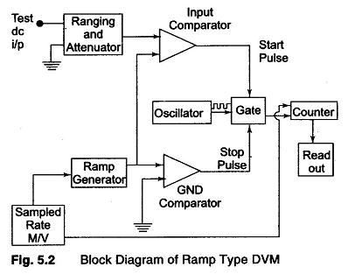
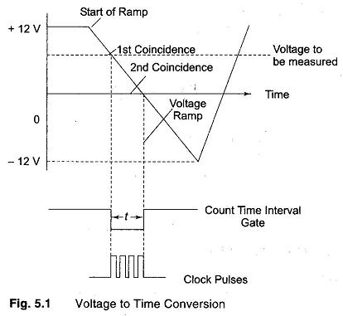
Analog-to-Digital Convertor: Ramp technique
+- 0.005% accuracy

Slide 3
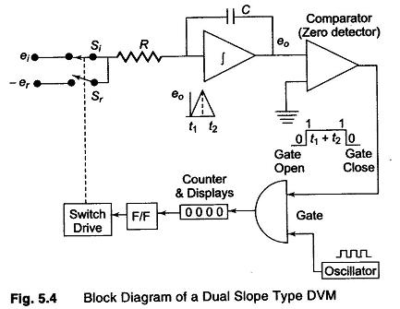
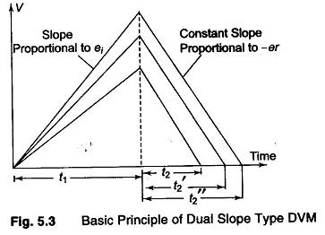
Analog-to-Digital Convertor: Dual-slope
Excellent noise rejection; +- 0.05% accuracy in 100 ms.

Slide 4
A/D Signal-to-noise ratio
The quantization process in the A/D converter produces noise in the converted signal.
The quantification of it is done in terms of signal-to-noise ratio (SNR) of A/D converter.
SNR = 6.02N + 1.76 dB (N-bit ADC)
https://www.analog.com/media/en/training-seminars/tutorials/MT-001.pdf

Slide 5
Bridge Circuits
Ubiquity of resistive sensors
Displacement
Pressure
Temperature
Humidity
Force
Flow
Bridge configurations
Non-linearity
Bridge sensitivity

Slide 6
Bridge Circuits

Slide 7
Bridge Compensation

Slide 8
Operational Amplifier
Signal conditioning
Amplification
Filtering
Linearization
Op-amp parameters
Open-Loop Voltage Gain, Slew rate, input offset voltage, input bias current, input offset current, output offset voltage Common Mode Rejection Ratio (CMMR), power supply rejection ratio (PSRR), differential input impedance, output impedance, average temperature coefficient of input offset current, average temperature coefficient of input offset voltage, output short circuit current, etc.

Slide 9
Amplifiers
Non-inverting amplifier
Non-ideal open loop gain
Inverting amplifier
Integrator
Input signal time period
Time-constant
Differentiator

Slide 10
Amplifier
Summing amplifier
Subtracting amplifier
Instrumentation amplifier
Selectable gain with high gain accuracy and gain linearity
Differential input capability with high common mode rejection
High stability of gain with low temperature coefficient (resistors and other components are manufactured with high precision )
Low DC offset and drift errors
Low output impedance

Slide 11
Two-OpAmp Instrumentation amplifier

Slide 12
Amplifier
Chopper amplifier

